Slide 1
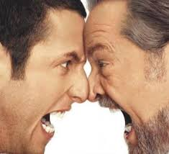
Being Foolish with a Fool
Ecclesiastes 10:12-20
Dr. Rick Griffith • Crossroads International Church Singapore
CICFamily.com • BibleStudyDownloads.org

Slide 2
FOOLS.
Notes:
Today I will speak on something I do not recall ever hearing a message about!
• Fools! We all have to deal with fools.

Slide 3
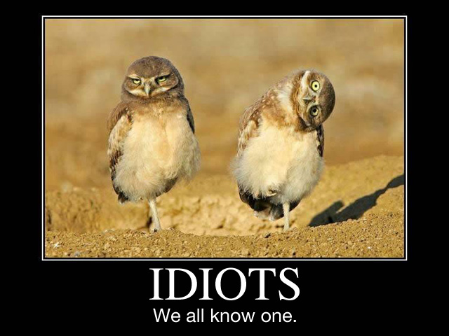
FOOLS
We all know one.

Slide 4
FOOLS
We've all been one.
Notes:
I've been a fool this very week!
So I can speak with experience!

Slide 5
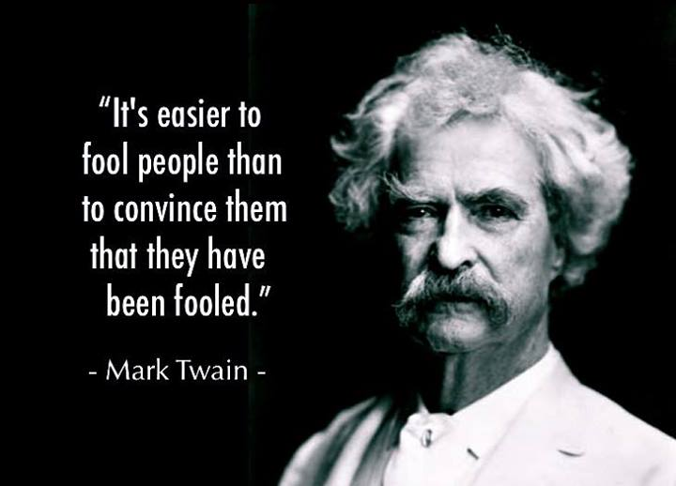
"It's easier to fool people than to convince them that they have been fooled." —Mark Twain

Slide 6
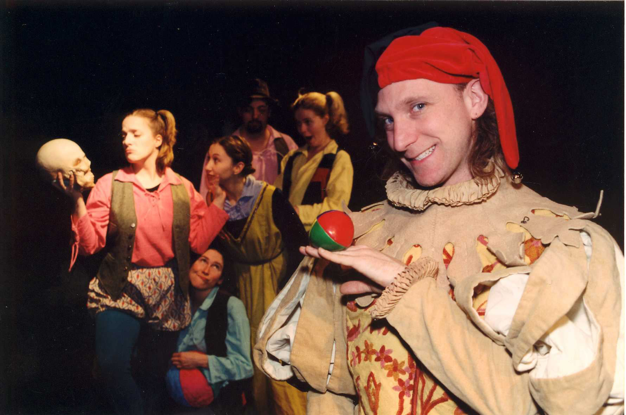
Can you spot a fool?
Can you handle a fool?
Notes:
If not, stay tuned!

Slide 7
Our Study in Ecclesiastes
Work & Wisdom Don't Last

Slide 8
Enjoy Your Work

Slide 9
Balance

Slide 10
Don't underestimate relationships!

Slide 11
Our Study in Ecclesiastes
Work & Wisdom Don't Last
Notes:
One series on this book calls it, "How to Waste Your Life."
How? All work, no play, or looking to work and wisdom for ultimate satisfaction.

Slide 12
Ecclesiastes Wisdom
LIVE WELL
LAUGH OFTEN
LOVE MUCH

Slide 13
Last Time in Ecc. 9:10–10:11 Why doesn't wisdom always lead to success?

Slide 14
I. Life is unfair (9:11–10:7).
Notes:
The inequities of life afflict the wise as well as the rest of us!
Our existence does not have all accounts settled fairly yet.
Wisdom recognizes this truth that humanity is biased and inequitable.

Slide 15
II. Life is uncertain (10:8-11).
Notes:
The unreliable nature of life hinders wisdom.

Slide 16
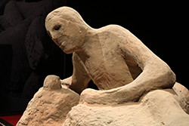
Main Idea
Wisdom doesn't guarantee success because life is unfair and uncertain.
Notes:
The 9 verses we will address today continue that theme of "why wisdom doesn't always lead to success" with a third answer. In a word, the answer is "fools."

Slide 17
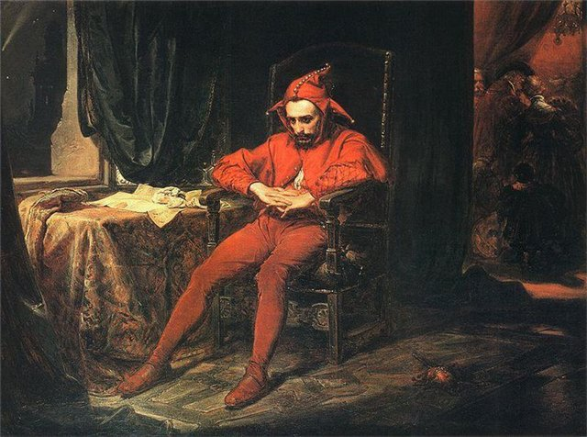
How should we deal with a fool?
Notes:
We all need to know how to deal with fools. There are plenty of them around.
My challenge in addressing this passage relevantly is to talk about fools without being foolish myself. How specific should I be? What one person thinks is a fool, another person considers a hero.

Slide 18
Solomon's Wisdom About Foolishness
Notes:
Despite the abundance of fools in our world, rarely do we describe foolishness for what it really is. But Solomon didn't mince any words when he spoke of fools. In fact, he paints a rather vivid picture of a fool in Ecclesiastes.
"In a day of soft diplomacy, straight-talk reality is rare. It seems that most statements are now couched in diplomatic terms so as not to offend anyone…" (Swindoll, LOTRE, 298).
Solomon's own son Adonijah qualified as a fool.
His other son Rehoboam also met the qualifications!

Slide 19
Our text today (Eccl. 10:12-20)
How to spot a fool (12-19)
What to do about it (20)
Notes:
(How can you identify a fool? Fortunately, Solomon gave us a…)

Slide 20
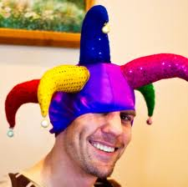
I. Description: The speech and actions of a fool are destructive (10:12-19).
Notes:
Fools both speak and act in a way that ruins.

Slide 21
A fool's speech is destructive (10:12-14a).

Slide 22
A wise man's speech wins him favor (10:12a).
A fool's speech hurts himself (10:12b)
but…
"Wise words bring approval"
"fools are destroyed by their own words"

Slide 23
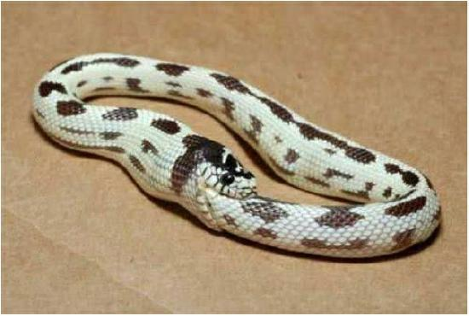
Fools hurt themselves.

Slide 24
A fool's speech hurts others (10:13-14).

Slide 25
A fool's speech hurts others (10:13-14).
"Fools base their thoughts on foolish assumptions, so their conclusions will be wicked madness;" (10:13 NLT).
"they chatter on and on.
No one really knows what is going to happen;
no one can predict the future" (10:14 NLT).
Notes:
Quality: Fools begin and end with foolishness (10:13).
A fool's words start with stupidity—not sensibility (10:13a).
A fool's words end with evil insanity—not good sense (10:13b).
Quantity: Fools talk too much despite their ignorance of the future (10:14).
Fools talk too much (10:14a).
Fools talk on, despite being ignorant of the future like us all (10:14b).
Fools talk on, despite being ignorant of what happens after they die (10:14c).

Slide 26
A fool's speech hurts others (10:13-14).
"Fools base their thoughts on foolish assumptions, so their conclusions will be wicked madness;" (10:13 NLT).
"they chatter on and on.
No one really knows what is going to happen;
no one can predict the future" (10:14 NLT).
Too much
Too ignorant
Too presumptuous
Notes:
Quality: Fools begin and end with foolishness (10:13).
A fool's words start with stupidity—not sensibility (10:13a).
A fool's words end with evil insanity—not good sense (10:13b).
Quantity: Fools talk too much despite their ignorance of the future (10:14).
Fools talk too much (10:14a).
Fools talk on, despite being ignorant of the future like us all (10:14b).
Fools talk on, despite being ignorant of what happens after they die (10:14c).

Slide 27
A fool's work is destructive (10:15-19).

Slide 28
"Fools are so exhausted by a little work that they can't even find their way home" (10:15 NLT).
Notes:
Work so exhausts fools that they can't do easy tasks (10:15).
But sometimes fools are workaholics instead. I know a Christian man who worked for 17 years without taking a day off. He lost his wife, his kids, his health, and his faith.
Yet this text speaks of the lazy fool…

Slide 29
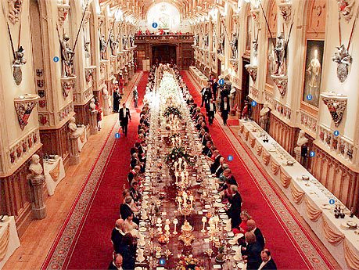
Foolish leaders hurt their subordinates (10:16-19).
"What sorrow for the land ruled by a servant, the land whose leaders feast in the morning" (10:16 NLT).
Notes:
Incompetent, undisciplined leaders hurt their subordinates (10:16).

Slide 30
"Hurt people hurt people"
Notes:
Isn't that so true?
The hurting begins too early in life for all of us.

Slide 31
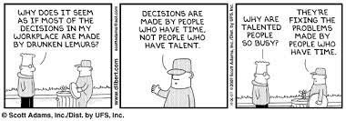
We all have to deal with fools.
Why does it seem as if most of the decisions in my workplace are made by drunken lemurs?
Decisions are made by people who have time, not people who have talent.
Why are talented people so busy?
They're fixing the problems made by people who have time.
Why does it seem as if most of decisions in my workplace are made by drunken lemurs?

Slide 32
Foolish leaders hurt their subordinates (10:16-19).
"What sorrow for the land ruled by a servant, the land whose leaders feast in the morning" (10:16 NLT).
"Happy is the land whose king is a noble leader and whose leaders feast at the proper time to gain strength for their work, not to get drunk" (10:17 NLT).
Notes:
A foolish leader ruins people and depletes their resources (10:18-19).

Slide 33
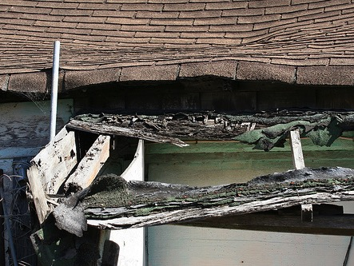
Foolish leaders hurt their subordinates (10:16-19).
"Laziness leads to a sagging roof;
idleness leads to a leaky house" (10:18 NLT).
Notes:
A foolish leader ruins people and depletes their resources (10:18-19).

Slide 34
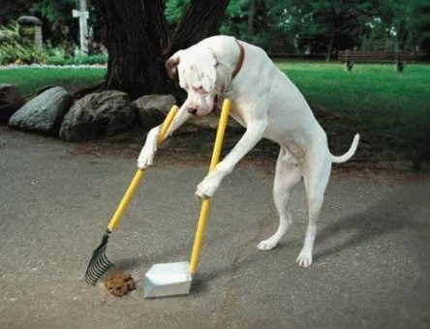
Fools never clean up their own messes.

Slide 35
Foolish leaders hurt their subordinates (10:16-19).
"A party gives laughter, wine gives happiness, and money gives everything!" (10:19 NLT).

Slide 36
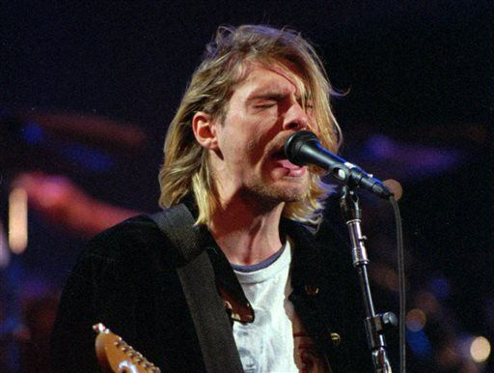
Being a rock star shortens your life by 20 years
Kurt Cobain of the Seattle band Nirvana performing in Seattle
Notes:
Rock Stars Really Do Die Young(er)
But they're not particularly vulnerable at 27, researcher notes
By Evann Gastaldo, Newser Staff
Posted Oct 29, 2014 8:20 AM CDT
(Newser) – The idea that rock stars die young is actually true, according to a new study out of Australia. Though most rock stars don't enter the so-called "27 Club," whose members all died at that age (Kurt Cobain, Jimi Hendrix, Janis Joplin, Amy Winehouse, Jim Morrison), the study finds that they do die much earlier than the average person. Researchers looked at 12,665 music industry deaths since 1950 and found that the average male musician lives just into his late 50s, while the average female musician lives only into her early 60s, the Wall Street Journal reports. Compare that to the average age of death for American men (75) and women (80) who are not in the industry. The study found that the rates of suicide, homicide, and fatal accidents are all significantly higher among rock stars than among the general population, the lead researcher writes at the Conversation.
"Across the seven decades studied, popular musicians' lifespans were up to 25 years shorter than the comparable US population," she writes. Why? She thinks it has to do with the lifestyle. "The industry itself actually supports outrageous behavior. Drugs are very prevalent—young musicians often take uppers to perform and then party all night with alcohol and drugs," she tells the Journal. Add that to the general stress of touring, and you have a recipe for disaster—particularly because the industry doesn't provide enough emotional support, she says. Rock stars "dream of being at the peak and that all of their psychological problems will somehow be relieved by adoration and squillions of dollars. What they actually come to is a sense of emptiness and an incredibly demanding lifestyle, where everybody is telling them what to do." (Lonely people also may not live as long.)

Slide 37
Fools sometimes get to the top
Notes:
Oftentimes these fools get to the top—not through their own doing, but due to favoritism by someone with power.

Slide 38
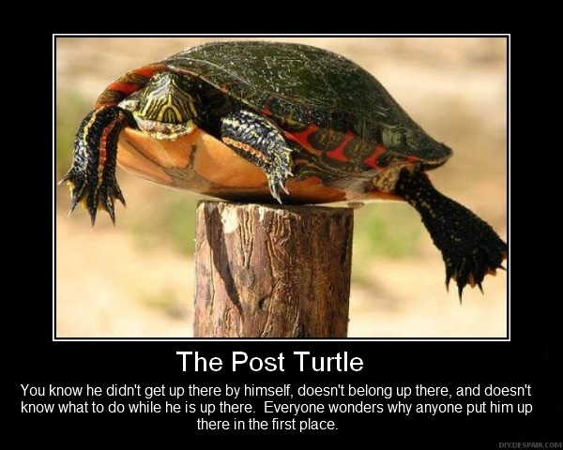
The Post Turtle
You know he didn't get there by himself, doesn't belong up there, and doesn't know what to do while he is up there. Everyone wonders why anyone put him up there in the first place.
Notes:
This has been epitomized by the famous "post turtle."

Slide 39
I. Description: The speech and actions of a fool are destructive (10:12-19).
Notes:
We've seen the major part of this passage now that describes the fool. If your leaders were placed by favoritism and showed the destructive speech and actions of a fool, it'd be tempting to criticize them. Solomon, aware of such a strong temptation, warns against speaking evil of inadequate leaders.

Slide 40
II. Warning: Don't even privately criticize foolish authorities because they may find out (10:20).
Notes:
Watch your tongue concerning your boss—or it might bite you.

Slide 41
"Never make light of the king, even in your thoughts. And don't make fun of the powerful, even in your own bedroom" (10:20a NLT).
Notes:
Do not curse a man in authority even in the privacy of your bedroom (10:20a).

Slide 42
"For a little bird might deliver your message and tell them what you said" (10:20b NLT).
Notes:
We shouldn't curse authorities because an unknown source may reveal our criticisms (10:20b).

Slide 43
How should we deal with a fool?
Notes:
(So let's return to where we started with the question, how should we deal with a fool? The answer?)

Slide 44
Don't criticize your foolish leader (Main Idea)
Notes:
When it comes to the superior with whom you disagree…
Keep your thoughts to yourself!

Slide 45
I. Description: The speech and actions of a fool are destructive (10:12-19).
Notes:
Solomon first described the fool's destructive speech and actions.

Slide 46
II. Warning: Don't even privately criticize foolish authorities because they may find out (10:20).
Notes:
Solomon then warned you to keep criticisms of your foolish leader to yourself
Watch your tongue concerning your boss—or it might bite you.

Slide 47
Have you criticized a superior? "It takes little size to criticize."
Notes:
Have you been critical of your church leaders, even in private?
Do you join the company gossip about your boss?
How quickly do you judge the decisions of your PM, president, judges, government officials, or other leader?

Slide 48
"How I hate my boss!"
Notes:
What should you do about hating your boss—or other superior—or even subordinate or relative or someone else?

Slide 49
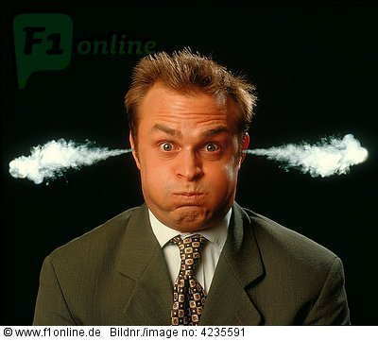
Keep your cool
Notes:
What good purpose has godless anger ever achieved?

Slide 50
Words can hurt or heal.
What did your words do today?

Slide 51
Hurtful words wound

Slide 52
Wise Words Heal

Slide 53
Black

Slide 54
OT Preaching link at BibleStudyDownloads.org
Get this presentation and script for free!

